Slide 1
Done by : Rawan Al-Qahtani
Dr : Mejdal Al-Qahtani
Arabic Tweets Classifying to Normal & Offensive

Slide 2
Introduction
This project is to classify the tweets if they offensive or not. The dataset was downloaded from web. Then preprocessed (tokenized ) to clean it from (diacritics- punctuations- emails and other things will be explained later). Then start classifying with supervised model Logistic Regression and Naive Bayes and compared between their results. Then finely, make unsupervised Topic Modeling LSA, LDA& NMF.

Slide 3
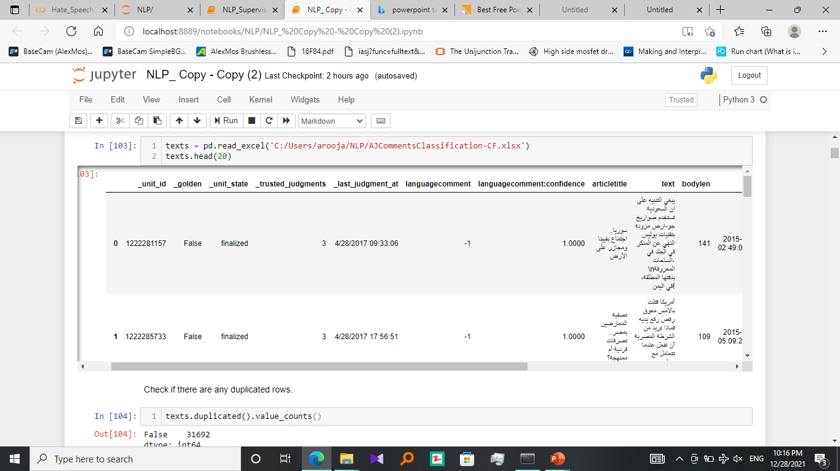
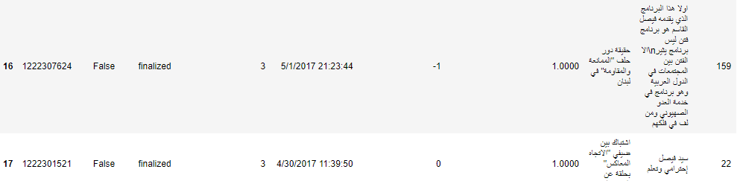
Dataset

Slide 4
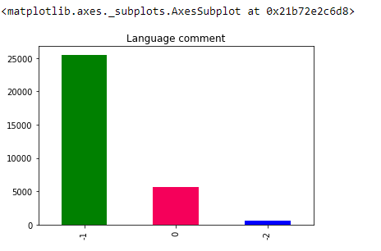
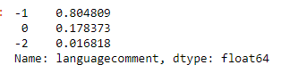
Dataset

Slide 5
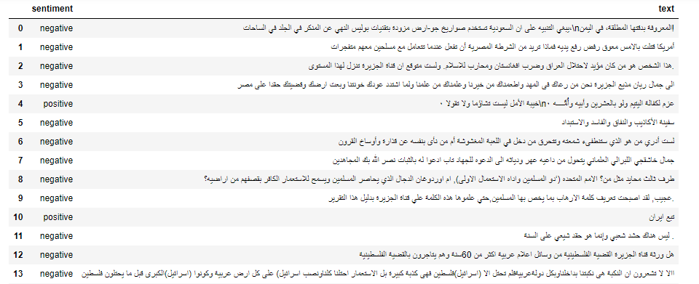
Dataset
sentiment

Slide 6
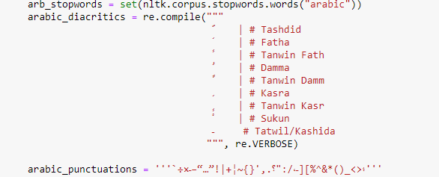
Data cleaning
cleaning the diacritics and punctuations

Slide 7
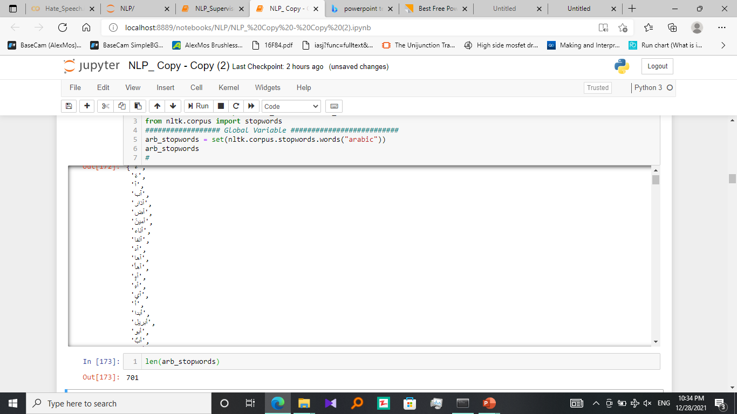
Data cleaning

Slide 8
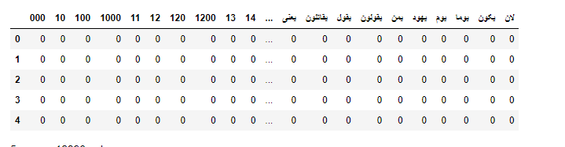
Superviesed document-term matrix

Slide 9
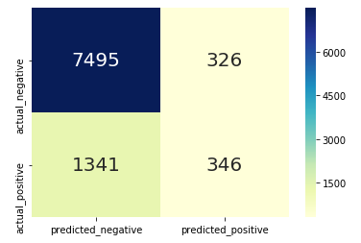
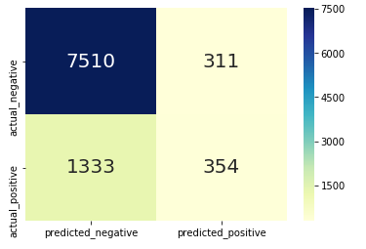
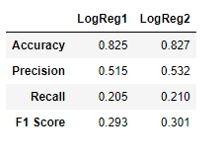
Superviesed lgisticregrison

Slide 10
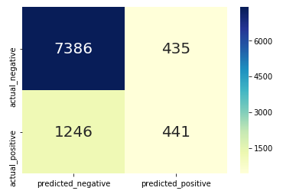
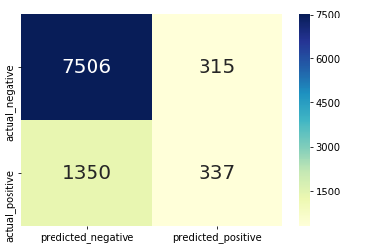
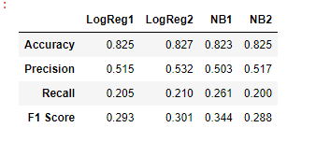
Superviesed
Naive Bayes

Slide 11
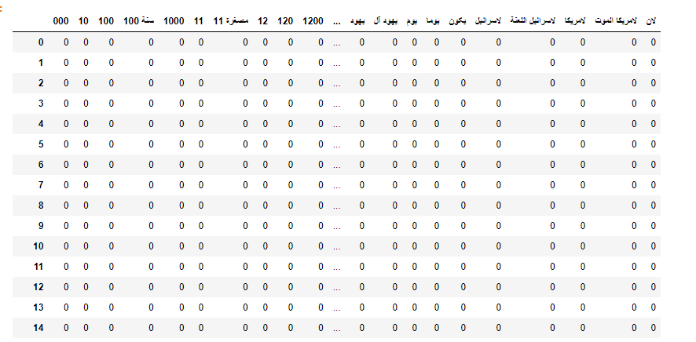
Unsupervised
CountVectorizer

Slide 12
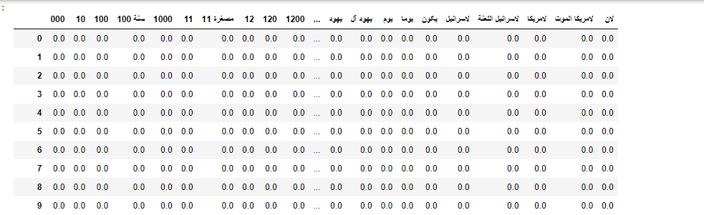
Unsupervised
TfidfVectorizeration

Slide 13
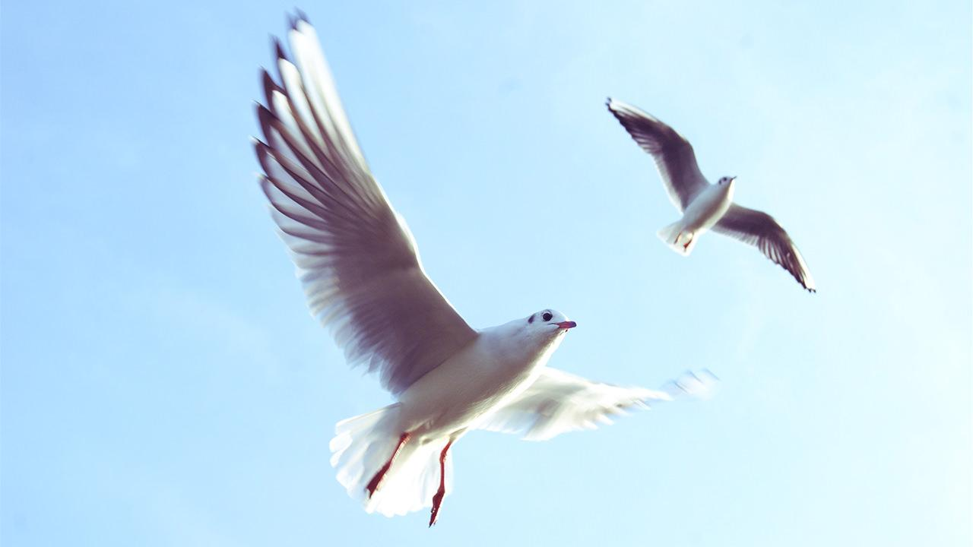
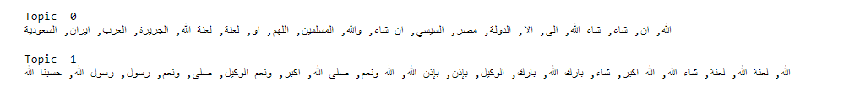
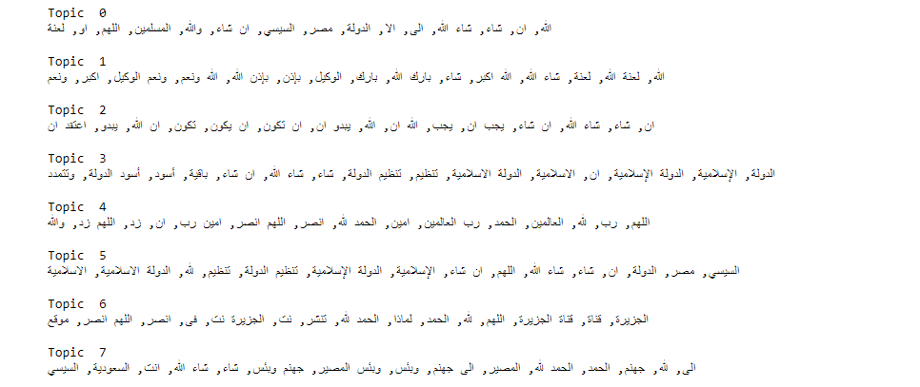
Topic Modeling
LSA model using features extracted from TF-IDF Vectorizer

Slide 14
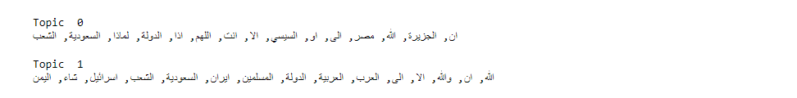

LDA model using features extracted from Count Vectorizer

Slide 15
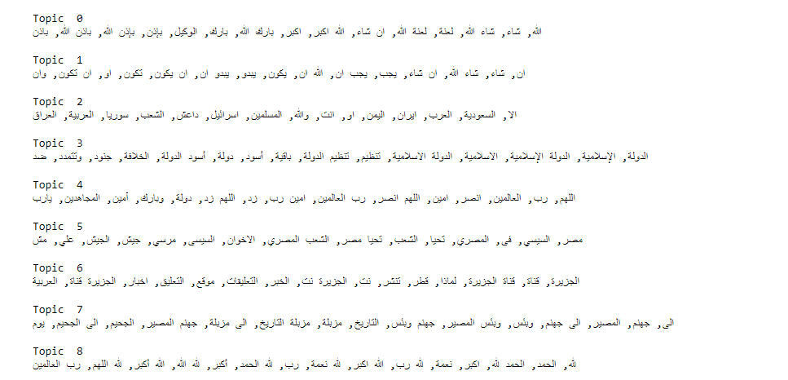
NMF model using features extracted from TF-IDF Vectorizer

Slide 16
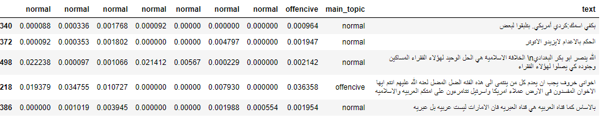
Categorize tweets by topic

Slide 17
Future work
Enhancing the module with larger dataset
Seeking more accuracy since Arabic words meaning change with different diacritics

Slide 18
Thanks

